Slide 1
ICS第六次小班课 11.12
MADE BY: Li zhuo & Wu Yiqian
TA：Wenhao Tang

Slide 2
Contents
Memory Hierarchy
Cache Memories
Mid-term Review

Slide 3
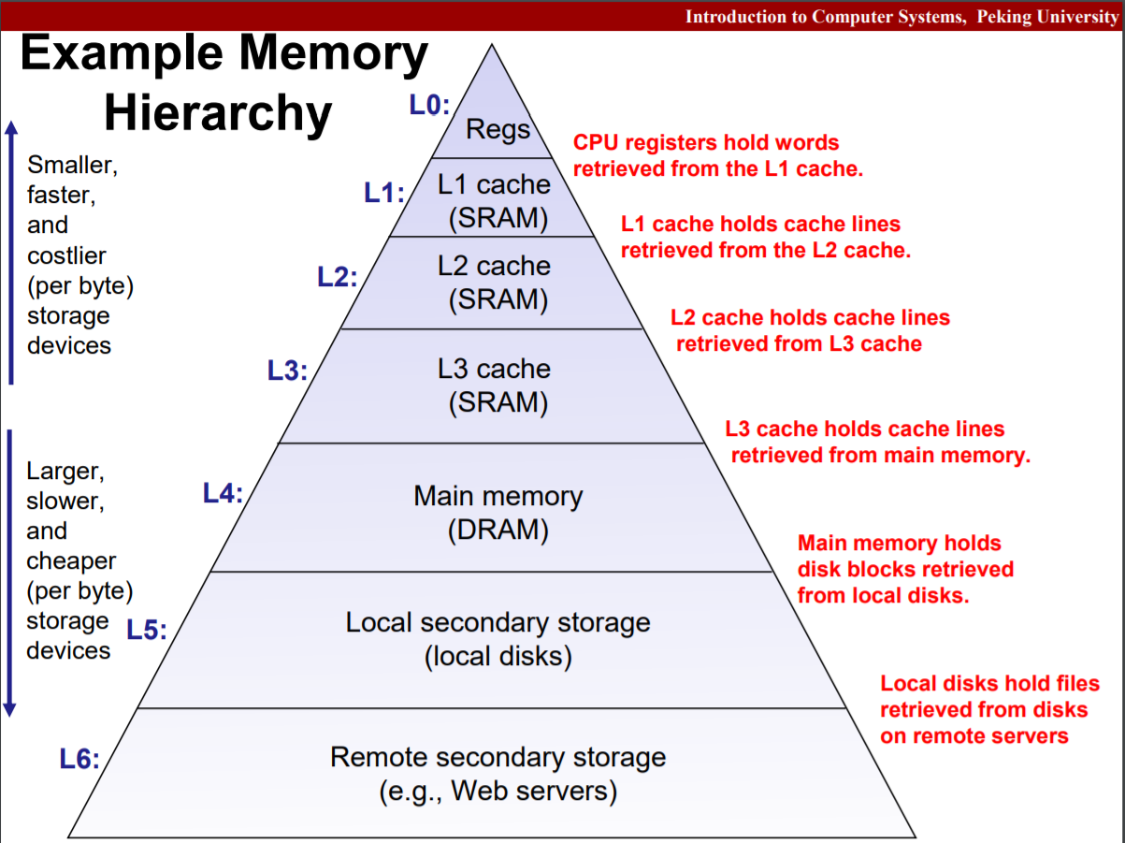

Slide 4
Memory Hierarchy
RAM
SRAM v.s. DRAM
DRAM:
内存模块
➡️ DRAM芯片(多个，例如8个)
➡️ 超单元(d=r*c个)
➡️ DRAM单元(w个，通常w=8)
➡️ 1位
Bus structure – Memory Read/Write Transaction

Slide 5
Memory Hierarchy
Random Access Memory(RAM)
Volatile, compared to hard disk
StaticRAM v.s. DynamicRAM
SRAM doesn’t need refresh
faster and more expensive
Used for cache memories
DRAM
Used for main memory

Slide 6
Memory Hierarchy
Bus structure
Memory read transaction and write transaction through I/O bus
RAS & CAS
Notes:
RAS和CAS共享地址线

Slide 7
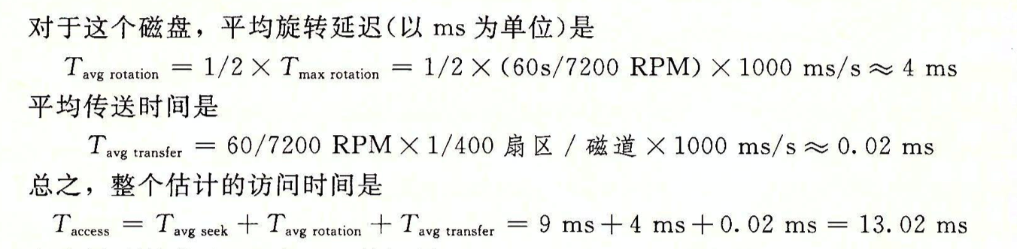

Memory Hierarchy
Disk:
$Capacity = \left(\#\frac{bytes}{sector}\right)∗ \left( \#\frac{avg. sectors}{track}\right)∗ \left(\#\frac{tracks}{surface}\right)∗ \left(\#\frac{surfaces}{platter}\right)∗ \left(\#\frac{platters}{disk}\right)$
Access Time: Seek + Rotation + Transfer

Slide 8
Memory Hierarchy
SSD
Sequential access faster than random access
Writes slower than Read
Modify a block page requires full page erasure and copy

Slide 9
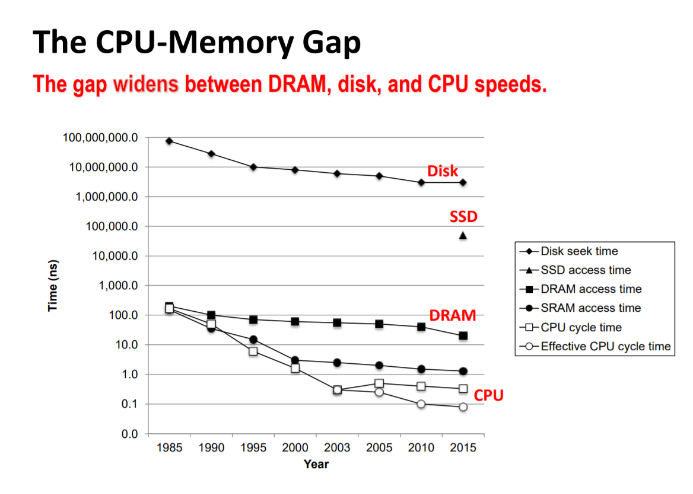
Memory Hierarchy

Slide 10
Memory Hierarchy
Locality: Temporal and Spatial
Cache

Slide 11
Cache Memories
Small, fast SRAM-based memories
Hold frequently accessed blocks of main memory
Cache hit
Cache miss

Slide 12
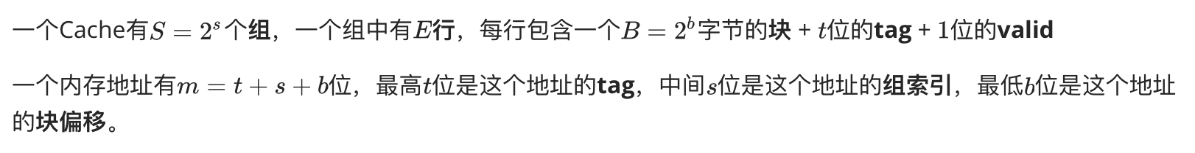
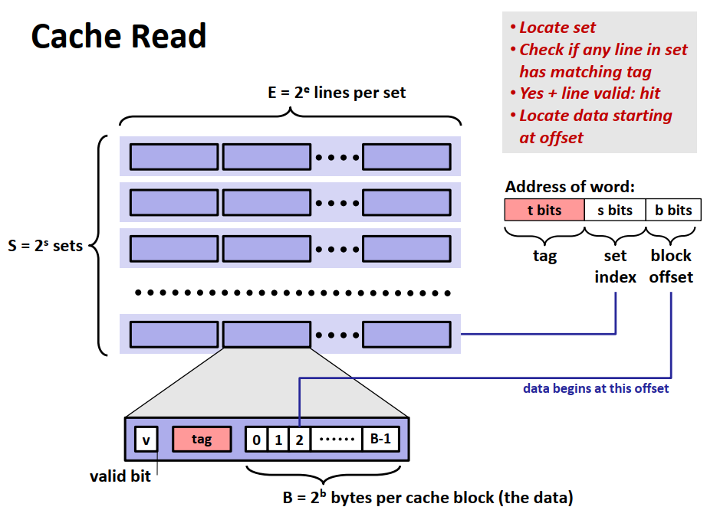
Cache Memories

Slide 13
Cache Memories
Direct Mapped Cache (E = 1)
not match: old line replaced directly
Associative Cache(E > 1)
One line in set is selected for eviction and replacement
Replacement policies: random, least recently used (LRU), LFU
Fully Associative Cache(S = 1, E = C/B)
search for many matching tags in parallel => expensive, should be small

Slide 14
Cache Memories
Write-hit
Write-through
Write-back
Write-miss
Write-allocate
No-write-allocate
Write-through + No-write-allocate
Write-back + Write-allocate

